Slide 1
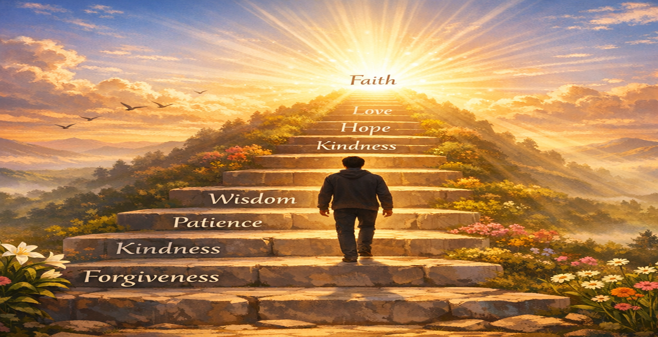

Setting Goals to be Perfect in 2026 (Matthew 5:48)

Slide 2
Matthew 5:48 (NASB)
Therefore you shall be perfect, as your heavenly Father is perfect.

Slide 3
This famous instruction is found in the Gospel of Matthew 5:48, serving as the conclusion to a section of Jesus’s Sermon on the Mount.

Slide 4
Meaning and Translation:
The Greek word used for "perfect" is teleios, which has a nuanced meaning in this context.

Slide 5
Completeness and Maturity:
Rather than meaning "flawless" or "sinless" in a modern sense, it denotes being whole, complete, fully developed, or having reached a designed end or goal.

Slide 6
Imitating Divine Character:
It is a call for believers to reflect the character of God, specifically His indiscriminate love and mercy. God expects his children to grow up to be mature.

Slide 7
When we rightly divide bible, God expects children to grow into spiritual maturity, moving from spiritual infancy to fully developed disciples who know His truth, can discern right from wrong, and reflect Christ's character,

Slide 8
becoming self-sufficient in faith and building up the community, not remaining tossed about by every new teaching. This growth involves deep knowledge of God's Word, humility, trust, and serving others, transforming believers to be more like Jesus.

Slide 9
Key Aspects of Spiritual Maturity

Slide 10
1) Knowledge & Understanding:
Moving beyond basic teachings to a deep knowledge of Christ and His Word

Slide 11
Hebrews 5:12-14 (KJV)
¹² For when for the time ye ought to be teachers, ye have need that one teach you again which be the first principles of the oracles of God; and are become such as have need of milk, and not of strong meat.

Slide 12
Hebrews 5:12-14 (KJV)
¹³ For every one that useth milk is unskilful in the word of righteousness: for he is a babe. ¹⁴ But strong meat belongeth to them that are of full age, even those who by reason of use have their senses exercised to discern both good and evil.

Slide 13
2) Stability:
Becoming firm in faith, not easily swayed by new or false doctrines

Slide 14
Ephesians 4:14 (KJV)
Wherefore he saith, Awake thou that sleepest, and arise from the dead, and Christ shall give thee light.

Slide 15
3) Christlikeness:
Growing to reflect Christ's character, living with humility, truth, and love

Slide 16
Ephesians 4:13 (KJV)
Till we all come in the unity of the faith, and of the knowledge of the Son of God, unto a perfect man, unto the measure of the stature of the fulness of Christ:

Slide 17
Ephesians 4:15 (KJV)
But speaking the truth in love, may grow up into him in all things, which is the head, even Christ:

Slide 18
4) Service:
Using spiritual gifts to build up the church (body of Christ) and serve others

Slide 19
Ephesians 4:12 (KJV)
For the perfecting of the saints, for the work of the ministry, for the edifying of the body of Christ:

Slide 20
5) Dependence & Trust:
Becoming like a child in dependence on God, but mature in understanding and action, not naive.

Slide 21
How Growth Happens

Slide 22
1) Desiring God's Word:
Like newborns craving milk, mature believers hunger for the sincere milk of the Word

Slide 23
I Peter 2:2 (KJV)
As newborn babes, desire the sincere milk of the word, that ye may grow thereby:

Slide 24
2) Discipline & Training:
a. It's a gradual, lifelong process involving connection with God, obedience, and humility, not automatic.
b. God gives spiritual leaders and gifts to equip believers for ministry and maturity

Slide 25
Ephesians 4:11-12 (KJV)
¹¹ And he gave some, apostles; and some, prophets; and some, evangelists; and some, pastors and teachers;

Slide 26
Ephesians 4:11-12 (KJV)
¹² For the perfecting of the saints, for the work of the ministry, for the edifying of the body of Christ:

Slide 27
Suggested Goals for 2026

Slide 28
MAKE UP YOUR MIND TO BE MATURE IN 2026
Attend every worship service, and bible class in 2026. (Hebrews 10:25-28)
Read the word of GOD every day.

Slide 29
Fervent prayer every day
Evangelize your world, people you come in contact with, tell the gospel.
Increase your offering by 1% - 5% do you love money more than GOD?

Slide 30
Invite 10 people to hear the preaching of truth.
Set up a bible class for your preacher.
STOP PROCRASTINATING Make up your mind to be perfect in 2026

Slide 31
Bring the Holy Spirit with you to worship and bible classes (fruit of the spirit).
Get the memory verse every week.

Slide 32
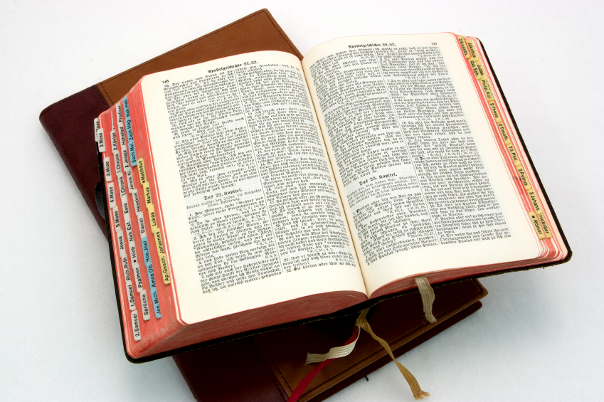
Hear: Romans 10:17
So then faith cometh by hearing, and hearing by the word of God.

Slide 33
Believe: Hebrews 11:6
But without faith it is impossible to please him: for he that cometh to God must believe that he is, and that he is a rewarder of them that diligently seek him.

Slide 34
Repent: Luke 13:3
I tell you, Nay: but, except ye repent, ye shall all likewise perish.

Slide 35
Confess: Matthew 10:32-33
32 Whosoever therefore shall confess me before men, him will I confess also before my Father which is in heaven.
33 But whosoever shall deny me before men, him will I also deny before my Father which is in heaven.

Slide 36
Baptize: Acts 22:16
And now why tarriest thou? arise, and be baptized, and wash away thy sins, calling on the name of the Lord.

